Slide 1
Florida Institute for Cybersecurity Research FIA Update: Physical Modeling
Pantha Protim Sarker
11/04/2024

Slide 2
Direction from Last Meeting
Goal:
ML based physical modeling for Fault Injection analysis
Task 1:
Physical modeling of Laser Fault injection
Paper
GOMACTech: Two-page abstract submitted, full paper work in progress
HOST: ML based EMFI analysis, currently working with Ansys team.

Slide 3
ML Based Physical Modeling of Fault Injection
Problem Definition
Developing an end-to-end approach for fault injection vulnerability assessment based on physical modeling
Fault can be single fault or multi fault
Developing a vulnerability assessment metrics
Should consider the effect of technology node sizing, and CAD library
Develop a ML based assessment
Research Questions
Can the modeling assessment be independent of the attack modalities (Ex.: Laser, Flash gun, EM coils etc.)?
Can larger sized gates in a security critical location (from SOFI) be an effective countermeasure without affecting the performance and overhead?
From gate level to layout level, increasing gate sizing will lead to optimization problem. How to optimize the place and route?

Slide 4
Fault Injection Attacks Overview
Fault Injection Attacks
Voltage Glitch
Clock Glitch
EMFI
Laser
Optical
V Depletion: increases delay in wire
V Spike: setup time violation
Period Decrease: Setup/hold time violation
Inducing Eddy Current
Focused Beam:
Transistor states change due to current flow
Focused Beam:
Transistor states change due to current flow

Slide 5
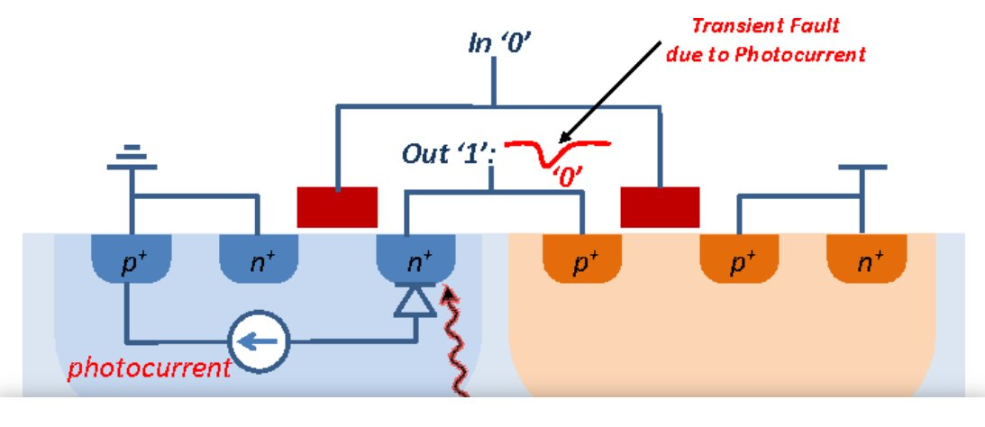
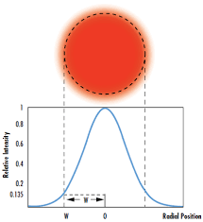
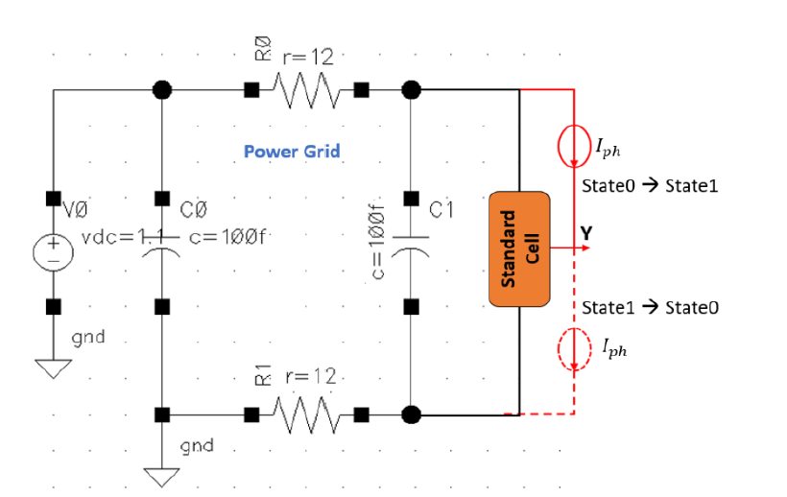
Fault Injection Modalities
Laser Fault Injection

Slide 6
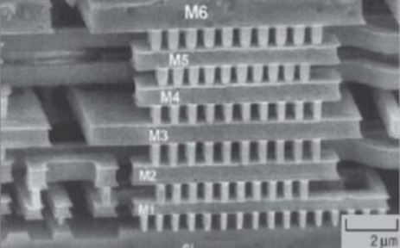
Optical Fault Injection
Optical fault injection preliminaries
Backside
Si bulk is transparent to ~1050-1300 nm
Which is near infrared region
Visible light wavelength 380-700 nm
Optical sources (other than near infrared laser) will not penetrate the bulk Si.
No high energy near infrared source(other than the laser source) is available.
Frontside
High power flashgun available in the market
Literature review: older technology node
350 nm technology
EEPROM, Flash memory
Latest 130 nm custom chip (Latest paper 2016)
Visible light
Si Substrate
Active region
Visible light
Metal Layers
Active region
Si Substrate

Slide 7
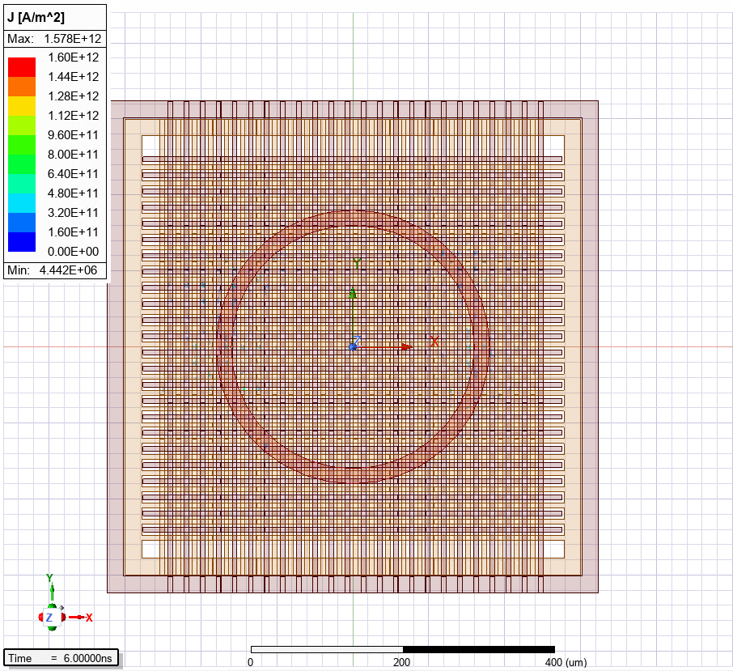
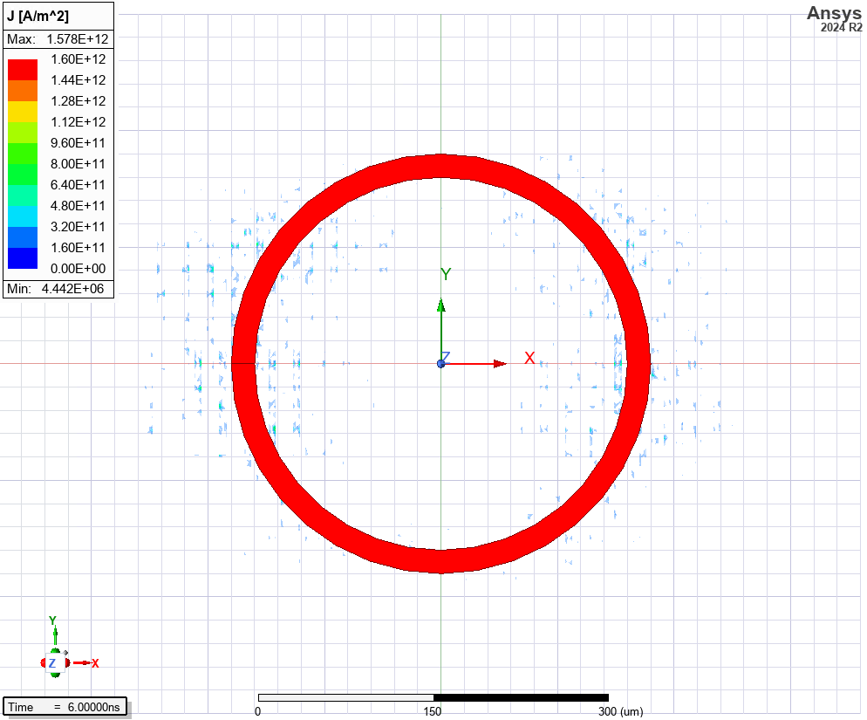
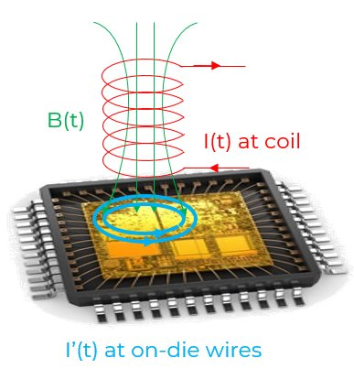
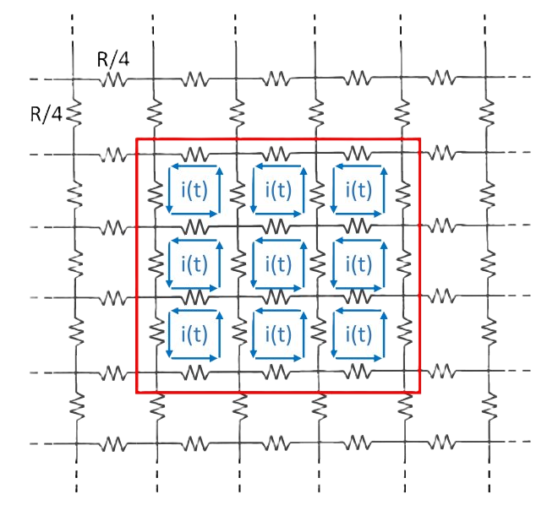
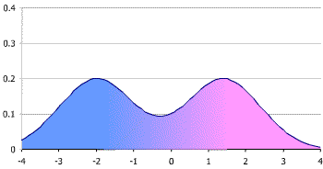
EM Fault Injection
Eddy current on the PG grid

Slide 8

Fault Injection Attacks
Voltage Glitch
Clock Glitch
EMFI
Laser
Optical
Fault Injection Attacks Overview
Focused Beam: Photocurrent
Radiation and focused beam: Induced Current?

Slide 9
Threat Model for Optical/Laser Fault Injection
Threat Model and Assumptions
An adversary’s objective is to tamper with security-critical locations and violate security properties
Grey box attack model
Require physical access to the target device
Non-invasive or semi-invasive(backside polishing) fault injection
Attacker has access to certain optical/opto-electrical setup-
Laser source, ex: Diode laser
Optical source, ex: Flash gun
XYZ stand for precise placement
Measurement tools, ex: PC, oscilloscope etc.

Slide 10
Fault Injection Modalities
Laser Fault Injection

Slide 11
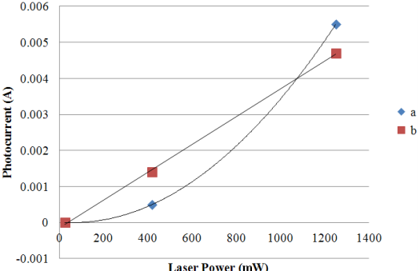
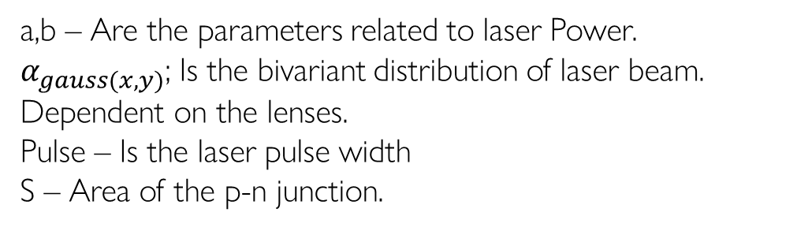
Electrical Modeling of the Laser
a,b – Are the parameters related to laser Power.
$α_{gauss(x,y)}$; Is the bivariant distribution of laser beam. Dependent on the lenses.
Pulse – Is the laser pulse width
S – Area of the p-n junction.
Laser power (1000 mW – 5000 mW) 45 nm Tech node
Iph-peak ~ (144 uA-600 uA)

Slide 12
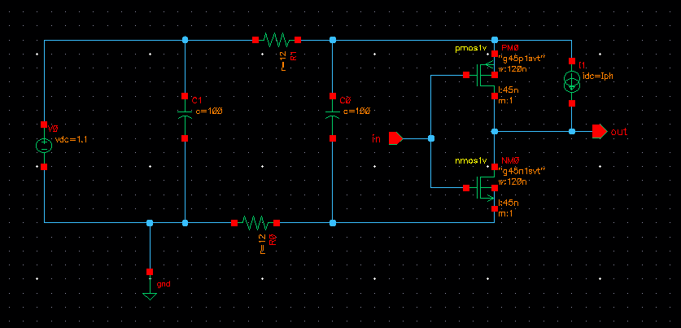
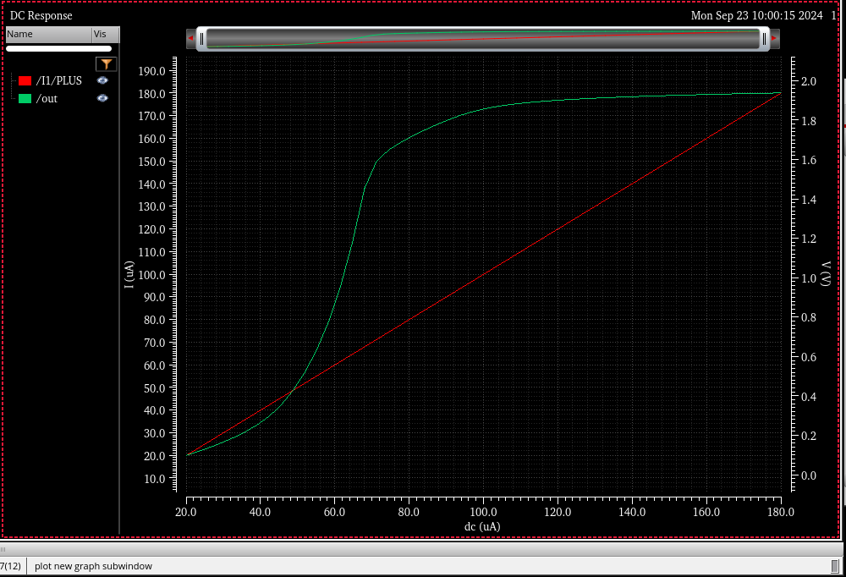
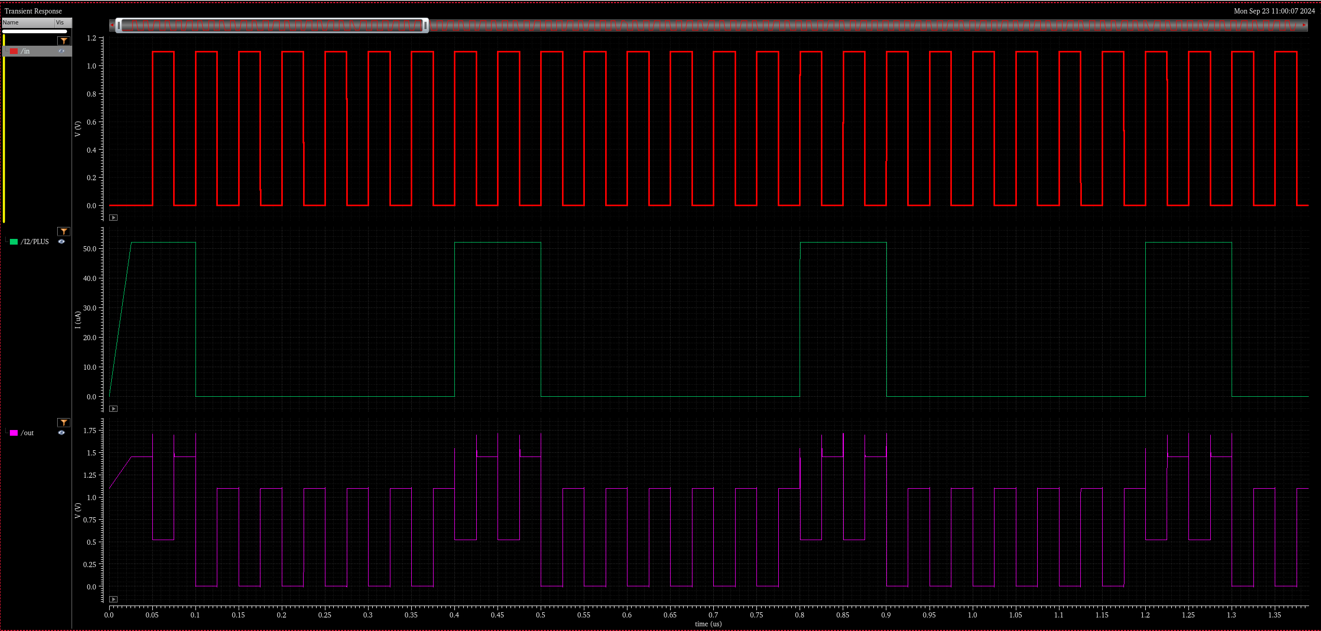
Spice Simulation of Standard Cells
Inverter
Laser sensitive region for output state 0 ->1
Laser sensitive region for output state 0 ->1

Slide 13
Standard Cell Simulation
Spice simulation for 45 nm tech mode during pull-up
Standard Cell | Iph Threshold (0 → 1) (uA) for Gate Size of 120nm (X1) | Iph Threshold (0 → 1) (uA) for Gate Size of 240 nm (X2) | Iph Threshold (0 → 1) (uA) for Gate Size of 480nm (X4)
Inverter | 57 | 120 | 227
Nand2x1 | 84 | 178 | 325
And2x1 | 81 | 163 | 313
Nor2x1 | 63 | 137 | 250
Or2x1 | 77 | 144 | 309
Xor2x1 | 88 | 164 | 345
Xnor2x1 | 86 | 172 | 332
AOI21x1 | 98 | 208 | 392
OAI21x1 | 101 | 199 | 412
AO21x1 | 97 | 190 | 368
DFF | 144 | 224 | 374

